Slide 1
Open source textbooks
Matthew Douglass – Eugene fedotov – jovaughn chin

Slide 2
Summary
With this project we wiill develop macros to simplify the drawing of diagrams for CS textbooks, and possibly other disciplines. These professional looking diagrams will improve on existing open source textbooks.

Slide 3
Goals
Learn
We were tasked with learning Plain TeXm LaTeX, DraTeX, AlDraTeX, TeX4ht and Prof. Bergmann’s macros for object diagrams and compilers.
Explore
We were tasked with looking into the need for diagrams in other disciplines. We were also be exploring existing facilities for colors and/or links in LaTeX.
Implement
We were tasked with implementing macros to facilitate the drawing of diagrams which need to be drawn, as well as interchangeable colors and ability to apply content links will implemented.

Slide 4
Minimum expectations
Arrays
Object diagrams
Linked Lists
HashTables
Stacks, Queues

Slide 5
Product features
Scalability
The ability for the diagrams to scale to either the page or to other objects around the diagram
Color Scheme
The diagrams will have the ability to have the color changed
Links
The support of links within a document to ease the transition to certain content.

Slide 6
Limitations
EDIT THIS WITH EVERYTHING NOT DONE

Slide 7
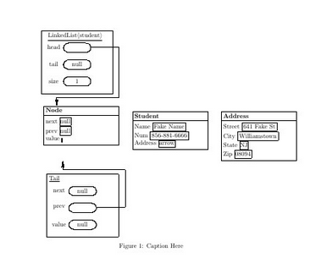

Base use of object diagram 1

Slide 8
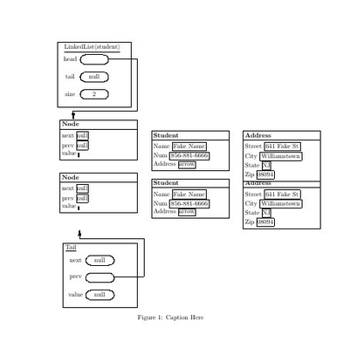

Base use of object diagram 2

Slide 9
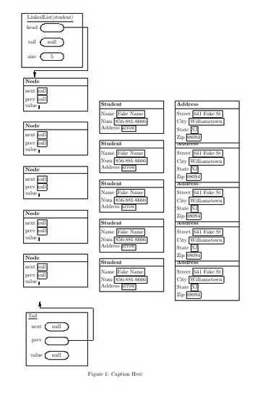

Base use of object diagram 5

